Slide 1
Lesson 12 – Homework review

Slide 2
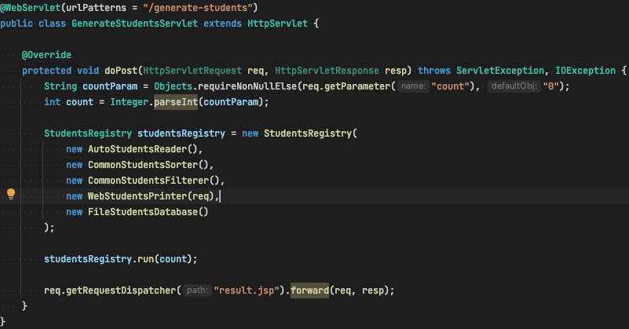
Servlet initialization

Slide 3
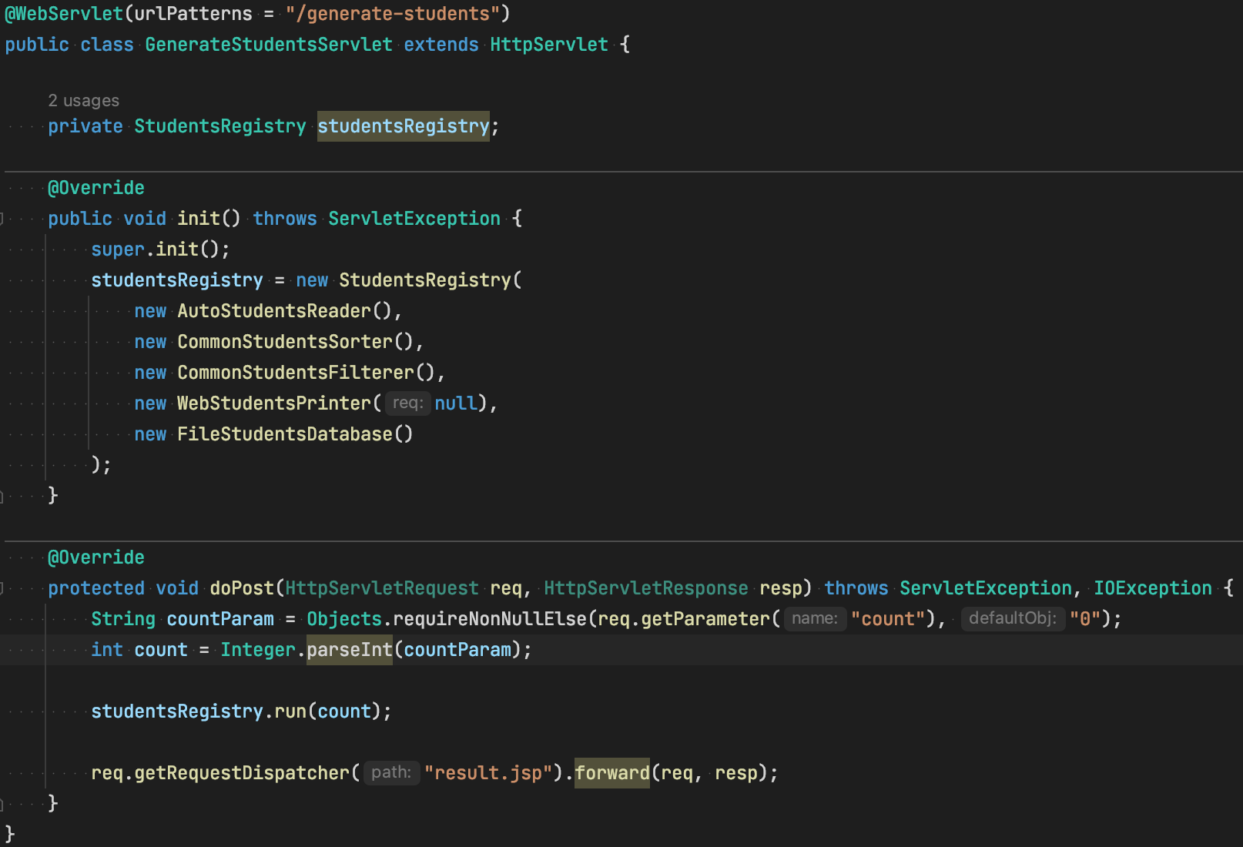
Servlet initialization

Slide 4
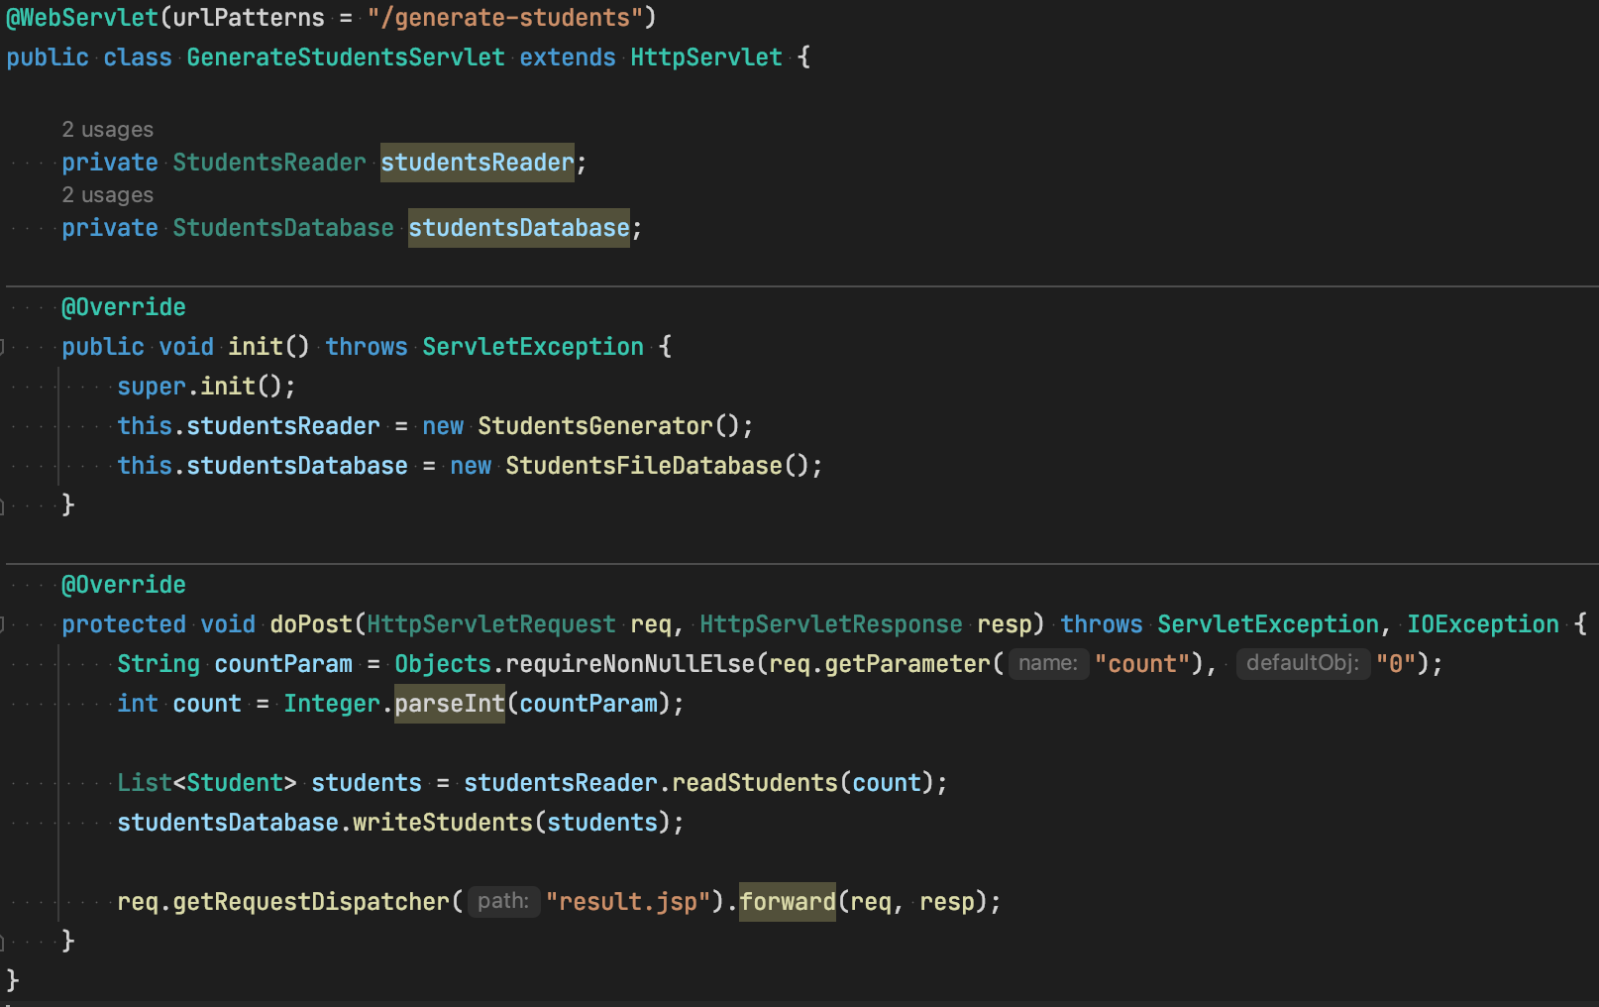
Servlet Performance

Slide 5
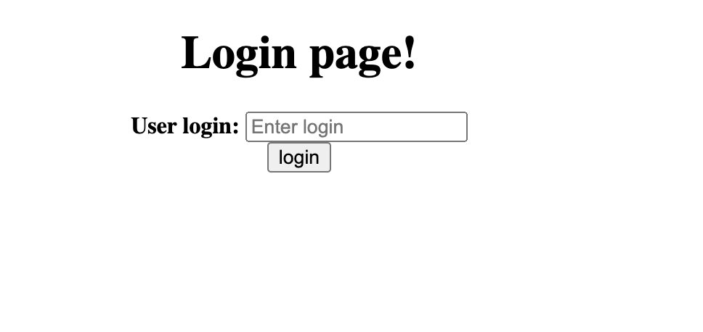
With ‘login’ also good to have ‘logout’

Slide 6
User input
In a WEB multiple user input is differrent than in console and can be reeplaced by a Servlet that generates multiple students(aka AUTO mode), and a dedicated servlet that can save only one student on each call

Slide 7
Servlet per component (SRP) examples
Dedicated Servlet for Student input
Dedicated Servlet for Printing
Dedicated Servlet for Login
…

Slide 8
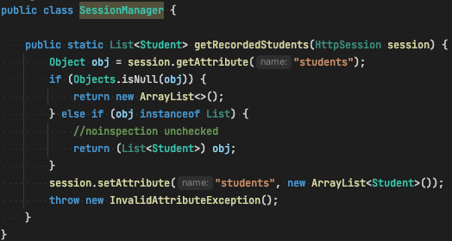
Session size problem

Slide 9
Thanks!
Any Questions?
Or find us in Slack:
@Yaroslav Brahinets
@Vasya Rudas

